Slide 1

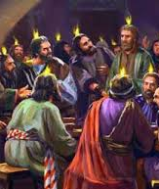

The blessing of community
Sunday service 19 May 2019
Cecil ang

Slide 2
Birth of the new testament church
Outpouring of the Holy Spirit on the 120
Apostle Peter’s first sermon brought in 3000 men
  More than 2500% increase in one anointed day!
  But many of those who had heard the word believed, and the number of the men came to about five thousand. Ac 4:4 ESV

Slide 3
Birth of the new testament church
“Truly, truly, I say to you, whoever believes in me will also do the works that I do; and greater works than these will he do, because I am going to the Father.” Jn 14:12 ESV

Slide 4
Acts 2:42-47 esv
⁴²And they devoted themselves to the apostles' teaching and the fellowship, to the breaking of bread and the prayers. ⁴³ And awe came upon every soul, and many wonders and signs were being done through the apostles. ⁴⁴ And all who believed were together and had all things in common. ⁴⁵ And they were selling their possessions and belongings and distributing the proceeds to all, as any had need. ⁴⁶ And day by day, attending the temple together and breaking bread in their homes, they received their food with glad and generous hearts, ⁴⁷ praising God and having favor with all the people. And the Lord added to their number day by day those who were being saved.

Slide 5

Five key characteristics of the early church
Spirit-filled (Ac 2:3-4, 33, 38)
Word-centred (Ac 2:42)
Outreach-focused (Act 2:47)
Relational (Ac 2:42, 44-45)
Devoted to Prayer (Ac 2:42)

Slide 6
Spirit-filled
“But you will receive power when the Holy Spirit has come upon you, and you will be my witnesses in Jerusalem and in all Judea and Samaria, and to the end of the earth.” Ac 1:8 ESV

Slide 7
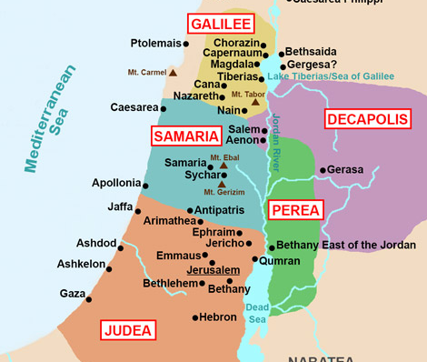
Spirit-filled
JERUSALEM
They were all filled with the Holy Spirit and began to speak in other tongues as the Spirit gave them utterance … telling in our own tongues the mighty works of God. Ac 2:4,11

Slide 8
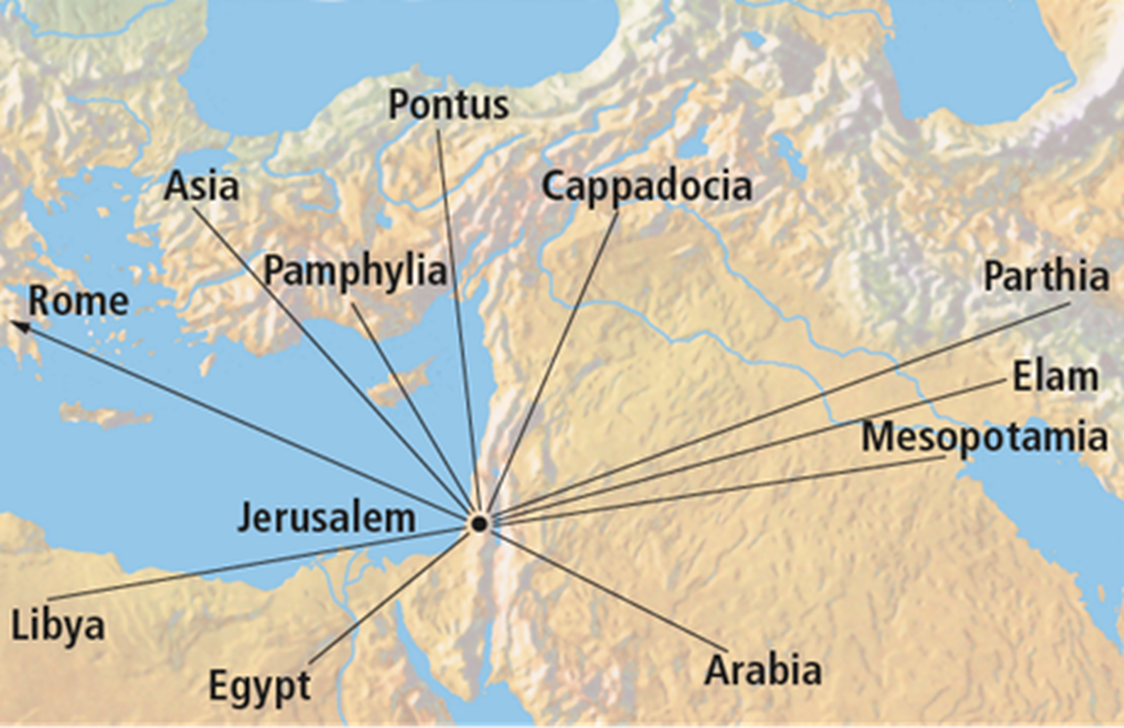
IMPACT ON THE DAY OF PENTECOST

Slide 9
Spirit-filled
SAMARIA
Peter and John … came down and prayed for them that they might receive the Holy Spirit … they laid their hands on them and they received the Holy Spirit.” Ac 8:15-17

Slide 10
Spirit-filled
CAESAREA
While Peter was still saying these things, the Holy Spirit fell on all who heard the word. And the believers from among the circumcised who had come with Peter were amazed, because the gift of the Holy Spirit was poured out even on the Gentiles. For they were hearing them speaking in tongues and extolling God. Ac 10:44-46

Slide 11

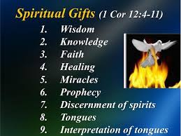
Spirit-filled application
Are we filled with the Holy Spirit each day?
“Do not get drunk with wine, for that is debauchery, but be filled with the Spirit, addressing one another in psalms and hymns and spiritual songs, singing and making melody to the Lord with your heart …” Eph 5:18-19 ESV

Slide 12
Word-centred
They devoted themselves to the apostles’ teaching
‘Oral tradition’ gave rise to the written gospels & letters of the apostles or close associates
Paul spent 2 years in the school of Tyrannus (Ephesus) reasoning with the disciples daily until all who lived in Asia Minor heard the word of the Lord, both Jews and Greeks (Ac 19:9-10); Paul wrote nearly half the NT

Slide 13
Word-centred
Jerusalem Council: in matters relating to doctrine, the apostles and elders were consulted (Ac 15)
Opposition to the gospel/Word
In the multitude of counsellors there is safety (Pr 11:14)
It is the application of God’s Word that transforms lives

Slide 14
Word-centred
¹¹ And he gave the apostles, the prophets, the evangelists, the shepherds and teachers, ¹² to equip the saints for the work of ministry, for building up the body of Christ, ¹³ until we all attain to the unity of the faith and of the knowledge of the Son of God, to mature manhood, to the measure of the stature of the fullness of Christ, ¹⁴ so that we may no longer be children, tossed to and fro by the waves and carried about by every wind of doctrine, by human cunning, by craftiness in deceitful schemes. Eph 4:11-14 ESV

Slide 15
Word-centred application
Are we spending enough time soaking in God’s Word to allow it to transform us?
“Let the word of Christ dwell in you richly, teaching and admonishing one another in all wisdom, singing psalms and hymns and spiritual songs, with thankfulness in your hearts to God.” Col 3:16 ESV
Go to www.menti.com & use the code shown

Slide 16
outreach-focused
They devoted themselves to the breaking of bread.… the Lord added to their numbers
Early disciples literally proclaimed the Lord’s death till He comes or He takes them home (1 Cor 11:26)
“This Jesus, delivered up according to the definite plan and foreknowledge of God, you crucified and killed by the hands of lawless men. God raised him up, loosing the pangs of death, because it was not possible for him to be held by it.” Ac 2:23-24 ESV

Slide 17
outreach-focused
Early disciples literally proclaimed the Lord’s death till He comes or He takes them home (1 Cor 11:26)
“Which of the prophets did your fathers not persecute? And they killed those who announced beforehand the coming of the Righteous One, whom you have now betrayed and murdered, you who received the law as delivered by angels and did not keep it.” Ac 7:52-53 ESV

Slide 18
outreach-focused
Holy Spirit directed the early church to set Barnabas and Saul apart for missionary work
While they were worshiping the Lord and fasting, the Holy Spirit said, “Set apart for me Barnabas and Saul for the work to which I have called them.” Ac 13:2 ESV

Slide 19
outreach-focused application
Are we convinced that the message of the Cross is still the good news to be proclaimed? Or have we grown cold in our first love?
For I am not ashamed of the gospel, for it is the power of God for salvation to everyone who believes, to the Jew first and also to the Greek. Rom 1:16
Go to www.menti.com & use the code shown

Slide 20
relational
They devoted themselves to fellowship (koinonia) … selling their possessions and distributing the proceeds to all … attending the temple together and breaking bread in their homes (oikos), they received their food with glad and generous hearts
Koinonia: sharing in common
The people gave voluntarily to help one another

Slide 21
relational
³² Now the full number of those who believed were of one heart and soul, and no one said that any of the things that belonged to him was his own, but they had everything in common. ³⁴ There was not a needy person among them, for as many as were owners of lands or houses sold them and brought the proceeds of what was sold ³⁵ and laid it at the apostles' feet, and it was distributed to each as any had need. ³⁶ Thus Joseph, who was also called by the apostles Barnabas (which means son of encouragement), a Levite, a native of Cyprus, ³⁷ sold a field that belonged to him and brought the money and laid it at the apostles' feet. Ac 4:32-37

Slide 22
relational
Encourage & build one another up (1 Th 5:11)
  Giving (Ac 20:35)
  Faithful to God (Heb 10:24-25)
  Sharing God’s Word
  Visitation
  Outings
Admonish one another (Col 3:16)
  Falsehood
  Conflict (Phil 4:2)

Slide 23
The power of togetherness
“If you want to go quickly, go alone. If you want to go far, go together.” African Proverb
“I can do things you cannot, you can do things I cannot; together we can do great things.” Mother Teresa

Slide 24
MAIN BENEFITS OF HAVING AN ACTIVE SOCIAL LIFE
You may live longer. People with more social support tend to live longer than those who are more isolated.
You will enjoy better physical health. Social engagement is associated with a stronger immune system, especially for older adults.
You will enjoy better mental health. Interacting with others boosts feelings of well-being and decreases feelings of depression.
You may even lower your risk of dementia. More recently, there has been accumulating evidence that socializing is good for your brain health. People who connect with others generally perform better on tests of memory and other cognitive skills.

Slide 25
Relational application
Are we a cell church?
What is keeping me from being involved in an Oikos?
²⁴ And let us consider how to stir up one another to love and good works, ²⁵ not neglecting to meet together, as is the habit of some, but encouraging one another, and all the more as you see the Day drawing near. Heb 10:24-25 ESV
Go to www.menti.com & use the code shown

Slide 26
Devoted to prayer
They devoted themselves to the prayers
  Disciples obeyed Christ commandment not to depart Jerusalem; they prayed in one accord (Ac 1:14).
  When under persecution, they cried out to God in one accord (Ac 4:24-30). The Upper Room was shaken and they were filled with the Holy Spirit once again (Ac 4:31).
  When Peter’s life was in danger, the church prayed for his release (Ac 12:12).

Slide 27
Devoted to prayer application
Are we a house of prayer?
What is keeping me from coming to P&P?
“Again I say to you, if two of you agree on earth about anything they ask, it will be done for them by my Father in heaven. For where two or three are gathered in my name, there am I among them.” Mt 18:19-20 ESV
Go to www.menti.com & use the code shown

Slide 28
Five key characteristics of the early church
Spirit-filled (Ac 2:3-4, 33, 38)
Word-centred (Ac 2:42)
Outreach-focused (Act 2:47)
Relational (Ac 2:42, 44-45)
Devoted to Prayer (Ac 2:42)

